Slide 1

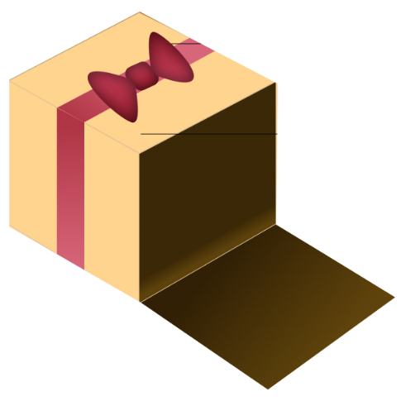

Slide 2
About today…
React
Render props

Slide 3
React
Router and Navigation

Slide 4
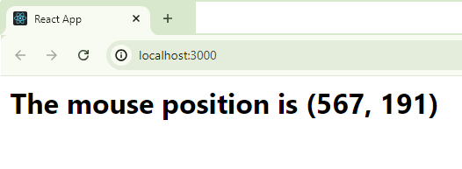
Introduction to Render Props
Intro
Render Props is a pattern in React where a component receives a prop that is a function
This function is used to render UI based on data or logic passed from the parent component

Slide 5
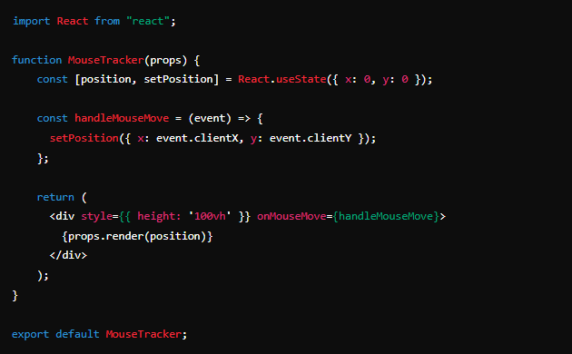
Basic Example
Content
Use Render Props to create a component that tracks mouse position and renders dynamic content based on that data

Slide 6
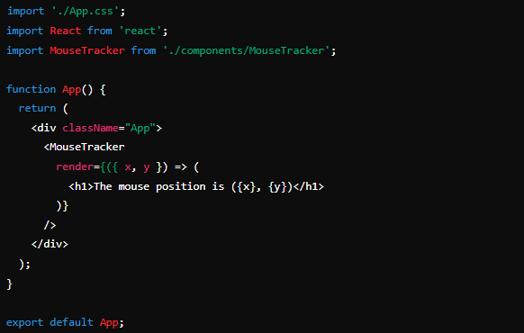
Using Render Props in the App Component
Content
Implement MouseTracker in the App component to render dynamic UI based on mouse position

Slide 7
Benefits of Render Props
Code Reusability
Share logic between different components without duplicating code
Flexibility
Customize rendering based on the data provided by the render prop
Component Composition
Separate logic and rendering concerns to make components more composable

Slide 8
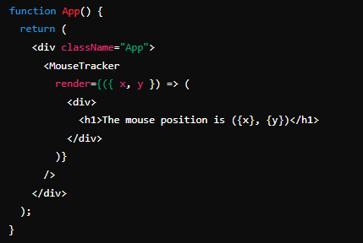
Advanced Use Cases for Render Props
Render props can be used for more complex scenarios such as :
Conditional rendering based on user input or state
Composing multiple render props for different functionalities

Slide 9
Best Practices for Render Props
Descriptive Prop Names
Use clear names for render props to make code more understandable
Avoid Deep Nesting
Prevent complex nested render props to keep code maintainables
Keep Logic Separate
Maintain separation between data logic and UI rendering to improve readability

Slide 10

What is a Render Prop in React?
Function prop passed to a component that returns React elements
What advantage does using Render Props provide when compared to other patterns?
Provide flexibility and reusability by allowing components to share logic and dynamic rendering
What is a common use case for the Render Props pattern?
Create components that handle complex logic or state (like mouse tracking) and pass the rendered output through a function prop to customize the UI
How can you avoid issues with deeply nested Render Props?
Use clear and descriptive names for props, and keep components focused on specific tasks

Slide 11


Slide 12

Task 1
Implement a simple component that tracks and displays mouse position using Render Props
Task 2
Extend the Render Props pattern to conditionally render different UI elements based on the mouse position

